Slide 1
Plan Your Way OK
Oklahoma State Department of Education
Pathways to Partnerships

Slide 2
Using Transition Assessment Results to Develop Meaningful Transition Plans for Students Participating in the Oklahoma Alternate Assessment Program (OAAP)
Claudia Beckner, M.Ed.
Temp Specialist, Secondary Transition
OSDE-Special Education Services
claudia.beckner@sde.ok.gov
Donna Tye-Lewis, M.Ed.
Project Manager, Pathways to Partnerships
OSDE-Special Education Services
donna.tye-lewis@sde.ok.gov

Slide 3
Agenda and Materials
8:15-8:30 Check-In: Agenda/Accessing Training Materials
8:30-9:15 Overview of Secondary Transition Requirements
9:15-10:30 Transition Assessments
10:30-10:45 Break
10:45-11:45 Partner Presentation
11:45-1:00 Lunch (On your own)
1:00-2:00 Case Study 1
2:00-2:15 Break
2:15-3:15 Case Study 2
3:15-3:30 Q &A/Evaluation

Slide 4
The Purpose of IDEA
The purposes of IDEA include ensuring that all children with disabilities have available to them a free appropriate public education (FAPE) that emphasizes special education and related services designed to meet their unique needs AND prepares them for further education, employment and independent living.
34 CFR 300.101(a)
Notes:
CLAUDIA
It is important to realize that one of the main purposes of IDEA has always included “transition.” In addition to the provision of special education and related services to provide FAPE (in the LRE) to meet the unique needs of SWDs, the purpose has always included preparation for further education, employment, and IL.

Slide 5
Oklahoma State Policy
Secondary transition services must be in effect before the beginning of the ninth-grade year, or on or before the age of 15, whichever comes first.
34 CFR 300.320(b)
Notes:
CLAUDIA
This means that the Transition Plan must be developed during the student’s 8th grade year or earlier.

Slide 6
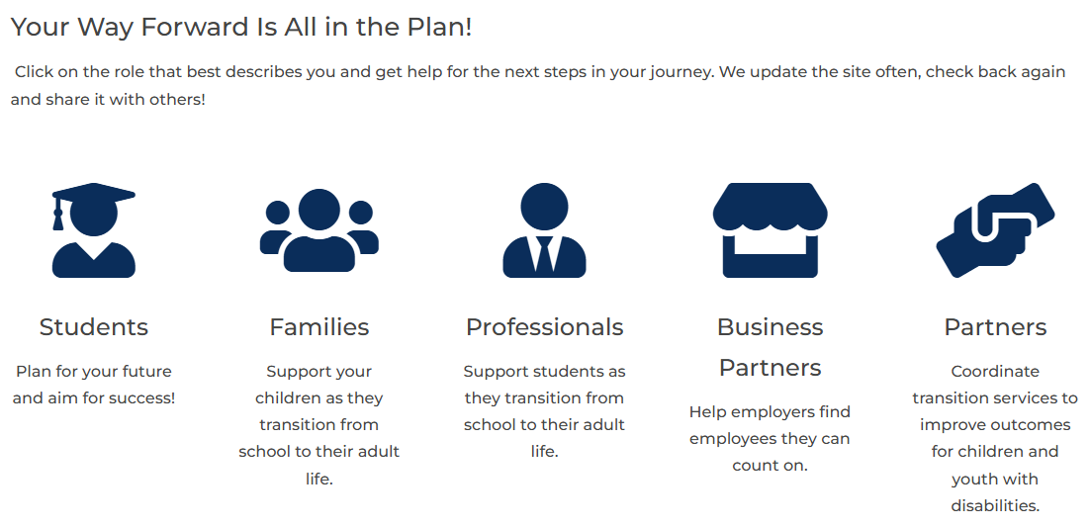
Plan Your Way OK
Provides easy‑to‑understand tools, information, and connections to services so you can stay informed, be active partners in transition planning, explore career options, and access innovative programs that lead to competitive, integrated employment and community belonging.
Notes:
CLAUDIA
PYWOK, developed through the OP2P grant, is a one-stop transition resource website for all transition stakeholders, with the goal of improving transition outcomes that lead to CIE and community belonging.
Organized for easy navigation by user type, Students, Families, Professionals, and Business Partners can find information, resources, tools, other transition collaborators and partners, all applicable to their role or roles in transition planning. For transition “Professionals” (that’s all of you) there are invaluable resources that will align with today’s presentation and more!

Slide 7
Better Post-School Outcomes
Compliant and Quality Transition Plans
=
Appropriate Transition Services
=
Better Post-School Outcomes
Notes:
CLAUDIA
Understanding the Predictors of Post-School Success, their alignment with compliant, quality transition plans and appropriate transition services provide a pathway to better post-school outcomes.
The Predictors of Post-School Success Guide, easily found under Guides and Guidance Briefs on the PYWOK Transition Planning page provides transition professionals with research-based, evidence-based, and promising practices useful for educators and young adult service professionals to equip youth and families with the skills and resources needed for adult living and working in the community.
The National Technical Assistance Center on Transition: The Collaborative (NTACT:C) identified sets of practices and predictors based on high-quality research in secondary transition.

Slide 8
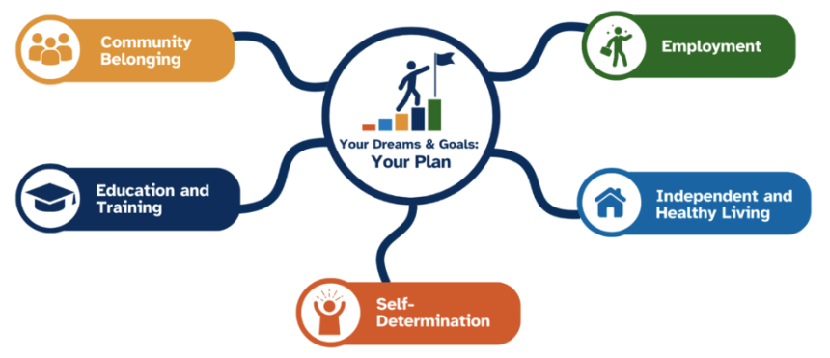
Secondary Transition Outcomes and Services
The Oklahoma Transition Council (OTC) developed student outcomes.
Reflect a natural progression toward independence, from exploration to planning, preparation, participation, and self-advocacy.
Help students, families, and professionals plan for the future.
Notes:
CLAUDIA
Through the OP2P grant the OTC and statewide transition stakeholders developed OK’s student outcomes for secondary transition.
Outcomes are defined in the areas of: self-determination, education and training, employment, independent living which includes healthy living, and community belonging.
The outcomes cover Pre-K through young adult and can be found on the PYWOK Transition Planning webpage presented as Outcome Statements for Professionals. Aligned “I Can” and “My Child Can” Statements are available on the Transition Planning page. Outcomes can also be found on the Students page under “Skills I Need for My Best Future”, on the Families’ and Professionals’ page under “Outcomes by Grade”.
They provide a natural progression across the grade span identifying clear skills that can support students as they explore careers, take part in their communities, build independence, and prepare for life after high school.
The Secondary Transition Outcomes and Services guide includes a list of statewide services and the outcome area they can support.
The Outcomes will also be available in two formats: a digitally accessible version that works with accessibility tools and a print-only version for easy printing and use in transition planning, instruction, and meetings.

Slide 9
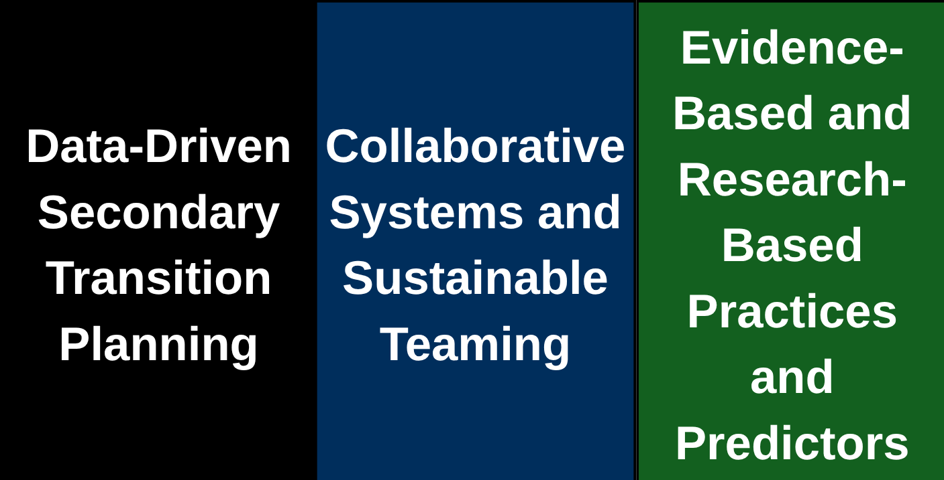
OK’s Secondary Transition Framework
Secondary Transition Framework Guide
Notes:
CLAUDIA
More info on and a visual of the STF and accompanying STF Guide can be found on the Transition Planning page of PYWOK website.
Similar to the OKMTSS Framework, the STF is organized around data-driven planning, collaborative systems/sustainable teaming, and EB- and R-B practices aligned with the Predictors of Post-School Success and secondary transition research.

Slide 10
Data-Driven Secondary Transition Planning
Age-Appropriate Transition Assessment Results
Postsecondary Goals
Annual Transition Goals
Transition Services, Coordinated Activities, and Courses of Study
Notes:
CLAUDIA
Age-App. Transition Assessment Results - Assessments/data is needed to drive secondary transition planning and to identify strengths, preferences, interests, and needs (SPIN)
Postsecondary goals are based on “SPI”-identified by assessments, student, and family input; goals must be measurable and updated annually, and occur after high school
Annual transition goals are based on “N”- identified from skill assessments. Annual goals, including objectives/benchmarks must be “SMART” – specific, measurable, achievable, relevant, and time-bound (however you learned it…); EdPlan format helps ensure all GOBs include condition, behavior, and criteria; and updated annually
Includes transition services and coordinated activities for each annual transition goal. Must be aligned with SPIN and help students meet post-secondary goals, include evidence and research-based practices with courses of study that coordinate with goals.

Slide 11
Collaborative Systems and Sustainable Teaming
Statewide Interagency Team – OK Transition Council (OTC)
Local and Regional Transition Teams
School and Community Teams
Individualized Education Program (IEP) Teams
Notes:
CLAUDIA
Statewide Interagency Team (aka OTC) includes representatives from all relevant stakeholders. The mission and vision are focused on improving student outcomes. Provides guidance and support to local and regional transition teams.
Local & Regional Transition Teams provide leadership support and fosters the engagement of students, families, and community stakeholders. Host effective meetings and implement effective practices to improve student outcomes.
School & Community Teams – help create a collaborative school culture fostering a commitment to equal access and intentional planning. Access and enhance school and community wide systems supporting transition services.
IEP Teams must be student-focused and student-led meetings, include individualized planning, and parent Involvement. Include collaborative decision-making based on students’ goals and plans and outside agency participation for coordination of services.

Slide 12
Evidence and Research-Based Practices and Predictors
School-Wide Supports and Student Development
Transition Education and Services
Effective Practices
Predictors of Post-School Success
  Predictors of Post-School Success Guide
  Predictors of Post-School Success OSDE Connect Course
Notes:
CLAUDIA
School-wide Supports & Student Dev. - Access to school-wide academic, behavioral, comprehensive counseling and mental health supports to foster student development. Access to career development, including Individual Career and Academic Planning (ICAP) – possible even for students who participate in the OAAP – see ICAP for Students with Significant Needs on SES-Secondary Transition webpage
Transition Education & Services - Grounded in quality research to improve student outcomes and aligned with the Predictors of Post-School Success. Must be student-focused, individualized, include multiple opportunities for student development, and provide instruction in self-determination and work-based learning.
Effective Practices - Specific interventions to teach skills to secondary students and youth with disabilities; based on the results of intervention research. Must include specially-designed instruction (SDI) aligned to the Predictors of Post-School Success.
Predictors of Post-School Success - Evidence- and research-based services, supports, or acquired skills identified to be associated with improved post-school outcomes for students with disabilities through correlational research by the NTACT:C. Includes the activities, services, and supports linked to higher success rates in adulthood. Aligned with OK’s STF you will find our Predictors of Post-School Success Guide and an accompanying OSDE Connect Course on the PYWOK Transition Planning webpage.

Slide 13
Data-Driven Secondary Transition Planning to Improve Outcomes
Notes:
DONNA

Slide 14
Transition Assessment Results Drive Development of Goals and Services
Present Levels of Performance including Current Transition Assessment Results
Measurable Postsecondary Goals
Annual Goals Related to Transition Service Needs
Courses of Study
Coordinated Set of Activities
Notes:
DONNA

Slide 15
Data-Driven Secondary Transition Planning Improves Outcomes
Student focused and student-led meetings
Use all available assessment data, including input from student and family
Set baselines for annual transition goals to meet specific needs identified from assessments
Develop and monitor progress toward postsecondary goals, annual transition goals and services
Motivate students and make it more personal and meaningful
Notes:
DONNA

Slide 16
Importance of Self-Determination
Starting with the 1990 reauthorization of the Individuals with Disabilities Education Act (IDEA) (P.L. 101-476), transition services must be based on student needs and include student interests and preferences.
Self-determined students have a stronger chance of being successful in making the transition to adulthood, including employment and independence. (Wehmeyer & Schwartz, 1997)
We strongly recommend that you assess your students in self-determination.
Notes:
DONNA

Slide 17
Self-Determination and Student Input
Make choices
Set goals, make plans to achieve goals
Attend the IEP meeting
Actively participate in the transition planning process
Lead the IEP meeting
Learn and practice self-determination skills
Notes:
DONNA

Slide 18
Student Participation
The student must be invited to attend their IEP meeting regardless of the level of their disability.
If they cannot attend, their preferences and interests must be considered.
34 CFR 300.321(b)
Notes:
DONNA

Slide 19
Outside Agency Participation
Representatives of participating outside agencies that are likely to be providing or paying for transition services must be invited with parent or adult student consent
  Department of Rehabilitation Services (DRS)
  Pre-Employment Transition Services (Pre-ETS)
  Department of Human Services Developmental Disabilities Services (DDS)
  OK Career Tech
  Mental Health
  Independent Living Centers
  Community Providers
  34 CFR 300.321(b)(3)
Notes:
DONNA

Slide 20
Outside Agency Resources
Plan Your Way OK Transition Planning
  Collaboration Guide Department of Rehabilitation Services and Local Education Agencies
  Collaboration Guide Developmental Disabilities Services and Local Education Agencies
Notes:
DONNA

Slide 21
Transition Assessments
Students must participate in age-appropriate transition assessments annually.
Transition assessments should be varied and facilitate the development of transition goals and services.
It is best practice to include a formal assessment that has validity and reliability.
It is also recommended to assess students in self-determination.
Notes:
DONNA

Slide 22
Types of Transition Assessments
Formal Assessments
  Validity-accurate, measures what it is supposed to measure
  Reliability-consistent results over time
  Examples: Achievement Tests, Self-Determination Assessments, Aptitude Tests, Adaptive Behavior Scales
Informal Assessments
  Examples: Interviews, Questionnaires, Observation, Transition Planning Inventories
Notes:
DONNA

Slide 23
Career Interest Inventories and Exploration Tools for Postsecondary Goal Development
Career Interest Inventories
  Provide students information about their top careers based on their strengths, preferences, and interests
Career Exploration Tools
  Help students match their interests and strengths to possible careers
  Provide clear information about top careers and different jobs
    What the work is like
    Skills and education needed
    How much they usually pay
    What the job outlook is
Notes:
DONNA
Inform Postsecondary goals in Employment, Education and Training

Slide 24
Transition Skills and Abilities Assessments for Annual Transition Goal Development
Transition skill assessments identify strengths, and abilities, skills, and needs.
These assessments are crucial when developing appropriate annual transition goals and services.
Use the needs identified in the transition assessments to build the annual transition goals.
Notes:
DONNA
Inform Annual transition goals and objective/benchmarks

Slide 25
Examples of Assessments that Inform Transition - 1
Curriculum-based assessments
Instructionally embedded assessments (OAAP/DLM)
State assessments (OAAP/DLM)
Classroom quizzes comprehension checks, essays, checklists
Ecological assessment
Functional behavioral assessment
Person-centered planning (e.g., I'm Determined, Charting the LifeCourse Tools)
Teacher questionnaires
Work samples
Notes:
DONNA
Comment from Claudia: This slide and the next are a mixed bag of transition assessment examples for developing both postsecondary goals and annual transition goals with benchmarks or objectives; we will address examples of specific assessments for type of goal in later slides

Slide 26
Examples of Assessments that Inform Transition - 2
Community mapping/Community questionnaires
Information from employers
Situational assessment
Information from students
Self-Determination Assessments
Parent survey & sibling interview & questionnaires
Observations (home/school/community) with data collection
Developing portfolios or e-portfolios (this process reveals new assessment information)
Notes:
DONNA

Slide 27
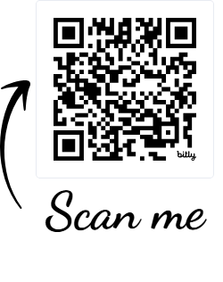
Transition Assessments for Students with Significant Support Needs (SWSSN)
Click on Transition Planning
Click on Transition Assessments
Review assessments listed
Identify assessments:
  that you currently use
  that you prefer to use
  that you would like to use with SWSSN
Click on a Transition Assessment Guide or Database and review
Select someone in your group to share
Notes:
DONNA
It is important that we utilize people first language that focuses on abilities

Slide 28
Purpose of Transition Assessments
Transition Assessment is an ongoing process of collecting data on the student’s “SPIN”
  Strengths
  Preferences
  Interests
  Needs
    The specific transition skills they need to be taught.
    These transition skills will become the annual transition goals.
Notes:
DONNA

Slide 29
Current Present Levels
The Present Levels of Academic Achievement and Functional Performance (PLAAFP) describe the level at which students are working academically and functionally (must be within a year).
Transition Assessment results must be documented in the IEP in the PLAAFP.
In OK EdPlan, the PLAAFP can be documented in:
  Assessment Narrative
  Overall Description
  Summary of Assessment under Current Assessments
  Transition Services Plan
The IEP team will utilize the data results to develop goals and services. 34 CFR 300.320(a)(2)
Notes:
DONNA

Slide 30

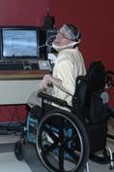
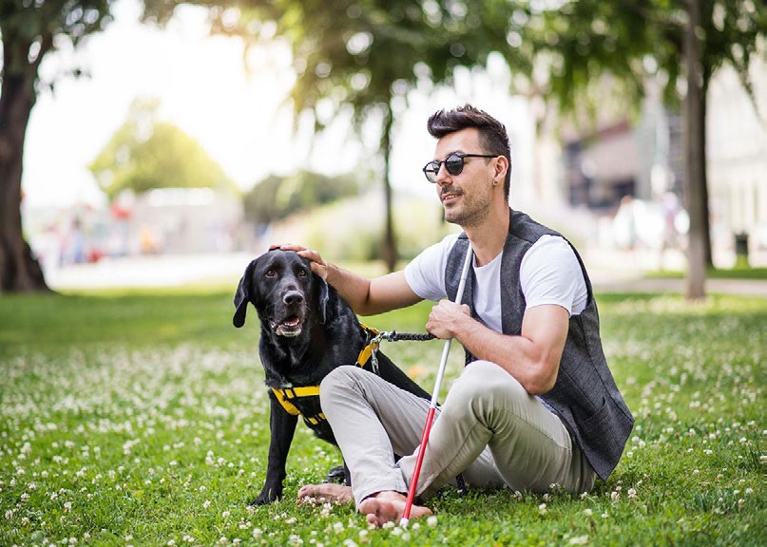

Assess All Transition Areas to Support Postsecondary Success for Students
Education and Training
Employment
Independent
Living
Community Participation
Self-Determination/Self-Advocacy
Notes:
DONNA
Students with significant support needs MUST be assessed in all four areas.
Best practice is to apply this to all students.

Slide 31
Measurable Postsecondary Goals
Present Levels of Performance including Current Transition Assessment Results
Measurable Postsecondary Goals
Annual Goals Related to Transition Service Needs
Courses of Study
Coordinated Set of Activities
Notes:
DONNA

Slide 32
Postsecondary Goal Requirements
Must be measurable and based upon age-appropriate transition assessments.
Must occur AFTER high school and updated annually.
Postsecondary Goal Areas:
  Education and Training*
  Employment*
  Independent Living (if appropriate)**
  Community Participation (if appropriate)**
*Required for all students
**Required for students who participate in the OAAP34 CFR 300.320(b)(1)
Notes:
DONNA

Slide 33
How to Develop Postsecondary Goals
Must be based on students’ strengths, preferences, and interests (usually from a career interest inventory).
Use a career interest inventory for the Employment and Education and Training Postsecondary Goals, when possible.
Start with Employment.
Get input from student and family.
Collaborate with outside agencies to develop attainable and appropriate postsecondary goals.
Notes:
DONNA

Slide 34
Postsecondary Goal Fluff Scale
Match Not as Important (Fluff OK)
Amount of Fluff
Firm Match
Elementary
Middle School
Freshman
Sophomore
Junior
Senior
Year in School
Notes:
DONNA
The OU Zarrow Center created the Postsecondary Fluff Scale:
In this case, fluff refers to the broadness and/or unrealistic characteristic of a student's postsecondary goal.
When students are younger, postsecondary goals can be fluffy!
In other words, It is perfectly fine for young students to have BIG, broad goals for themselves.
These big goals may not firmly match the student’s skills, abilities, and interests when they are younger.
As students get older, particularly those who are in high school, goals need to more firmly match the student’s skills, abilities, and interests.
As students age and explore other career options, their goals should be more realistic or concrete.
Their BIG dream goals can remain, but their plan to reach those goals needs to be realistic and actionable. If not, they likely have to choose different goals for themselves.

Slide 35
Postsecondary Education Options
2-year College
Community College/ Jr. College
Technical College
4-year University
  Private/Public
  Local, in-state, out-of-state
Inclusive Postsecondary Education (IPSE)
  Opportunity Orange (OSU)
  Riverhawk Scholars (Northeastern)
  Sooner Works (OU)
  Trailblazer Thrive Together (OCCC)
On the job training
Apprenticeships
Adult education classes
Project Search (if after HS)
Learning environments at group homes
Community experiences/learning experiences, social programs, libraries, art programs, churches
Notes:
DONNA

Slide 36
Postsecondary Employment Options
How often? Full-time, part-time
What type? Competitive, sub-minimum, volunteer, entrepreneurial, community integration/participation
Career type? Area of interest based upon preferences
Supports needed? Vocational rehabilitation, work skills trainer, coworker, assistive technology
Location? Place of employment
Notes:
DONNA

Slide 37
Independent Living Options
At home with family
  At home with family as independently as possible
  With what supports (medical, care givers)
With roommates
  With roommates in the dorm
  With roommates in a house or apartment
In the Dorms
  With or without roommates
Group homes
  Level of support given
Assisted or Independent Living facility
  Level of independence or support given
Notes:
DONNA

Slide 38
Community Participation Options
Access needed services
Transportation
Hobbies and leisure activities (gardening, playing games, collecting)
Recreation (playing sports, going to the park, hiking)
Spiritual, faith-based, cultural
Social groups (self-advocacy, citizenship/political groups)
Fine arts (theater, concerts)
Entertainment (movies, dining out, sporting events, car shows)
Community events, festivals, rodeos, parades, marathons, walks
Family events
Shopping, going to the post office, dances, dating
Independent living centers
Healthy lifestyle, safety and security
Volunteer
Notes:
DONNA

Slide 39
Data for Postsecondary Goals for SWSSN
LifeCourse Tools and other person-centered planning tools
Pictorial Career Interest Inventories and Career Videos
Personal Preferences Inventory
Employment Support Indicators
Person-Centered Planning Tools
Family Input
Situational Assessments
Notes:
DONNA

Slide 40
Using Transition Assessment Results
Present Levels of Performance including Current Transition Assessment Results
Measurable Postsecondary Goals
Annual Goals Related to Transition Service Needs
Courses of Study
Coordinated Set of Activities
Notes:
DONNA

Slide 41
Annual Goals
Each postsecondary goal must have a corresponding annual transition goal.
  Must address each specific transition need identified from the assessment data to address what skills the student will learn in the timeframe of the IEP to demonstrate movement toward reaching Postsecondary Goals.
Must be updated annually using new assessment data.
Are not mere statements of passing a class with a certain grade or to complete requirements for high school graduation.
34 CFR 300.320(a)(2)(i)
Notes:
DONNA

Slide 42
Annual Goals Areas
Postsecondary Goal Areas:
  Education and Training*
  Employment*
  Independent Living (if appropriate)**
  Community Participation (if appropriate)**
    *Required for all students
    **Required for students who participate in the OAAP
Notes:
DONNA

Slide 43
Annual Goal Requirements
Students assessed by alternate achievement standards, must have short-term objectives/benchmarks.
A goal must have at least two objectives.
  Objectives can be graduated components/steps toward the goal, increasing criteria toward reaching the goal, or varying/fading conditions under which the student reaches the goal.
Notes:
DONNA

Slide 44
Measurable Annual Transition Goals
Annual Transition Goals need to include the following:
  Condition (When, How, with What)
    The application of skills or knowledge
  Behavior (Specific)
    Identifies the performance being monitored
    Describes the materials/environment necessary to complete goal
  Criterion (To what degree)
    Duration (How Long, How Often)
    Degree of Accuracy
    Number of Trials
    Frequency
Notes:
DONNA

Slide 45
Creating Annual Goals - 1
Education and Training: What skills do I need to learn in the timeframe of this IEP to learn and/or go to school where I want? (e.g., self-determination, reading comprehension, behavior, communication, assistive technology, study skills, etc.)
Employment: What skills do I need to learn in the timeframe of this IEP to work where I want? (e.g., employability skills, positive behavior strategies, communication, self-advocacy, etc.)
Notes:
DONNA

Slide 46
Creating Annual Goals - 2
Independent Living: What skills do I need to learn in the timeframe of this IEP to live where I want? (e.g., money management, health, safety, cooking/cleaning, etc.)
Community Participation: What skills do I need to learn in the timeframe of this IEP to participate in my community? (e.g., self-determination, communication, assistive technology, positive behavior strategies, mobility, social skills, etc.)
Notes:
DONNA

Slide 47
Data for Annual Transition Goals for SWSSN
Curriculum-based and teacher-made assessments
Instructionally embedded assessments (OAAP/DLM)
State assessments (OAAP/DLM)
Observations/Situational Assessments/Task Analysis with data collection (home/school/community/work-based)
Adaptive Behavior and Life Skills Assessments/Checklists
  Adolescent Autonomy Checklist
  PEATC Life Skills Checklist
Self-determination checklists/rating scales
Notes:
DONNA

Slide 48
More About Annual Transition Goals
Monitor progress of annual transition goals
Plan for student involvement
OSEP Letter to Pugh
Notes:
DONNA

Slide 49
Courses of Study
Present Levels of Performance including Current Transition Assessment Results
Measurable Postsecondary Goals
Annual Goals Related to Transition Service Needs
Courses of Study
Coordinated Set of Activities
Notes:
DONNA

Slide 50
Courses of Study Information
Identify the specific courses that a student will take, whether special education or general education, that directly support progress toward postsecondary and annual goals.
Must be updated annually.
Must list the specific names of the courses for the student’s current and remaining years in school.
  Stay away from the word "elective.
34 CFR 300.320(b)(2)
Notes:
DONNA

Slide 51
Coordinated Set of Activities
Present Levels of Performance including Current Transition Assessment Results
Measurable Postsecondary Goals
Annual Goals Related to Transition Service Needs
Courses of Study
Coordinated Set of Activities
Notes:
DONNA

Slide 52
Coordinated Activities
A coordinated set of activities for a child with a disability that is:
  Results-oriented process;
  Focused on improving the academic and functional achievement of the child with a disability to facilitate the child's movement from school to post-school activities, including postsecondary education, vocational education, integrated employment (including supported employment), continuing and adult education, adult services, independent living, or community participation;
34 CFR 300.43(a)
Notes:
DONNA

Slide 53
Coordinated Activities-Services
Based on the child's needs, taking into account the child's strengths, preferences, and interests; and includes:
  Instruction
  Related services
  Community experiences
  Employment and other post-school adult living objectives
  Daily living skills and provision of a functional vocational evaluation, if appropriate.
Notes:
DONNA

Slide 54
Coordinated Activities-Tasks
These are the tasks/activities for the student to complete that will assist them in learning the skills and knowledge associated with each annual transition goal.
Consider activities that the student might benefit from or participate in to achieve each annual goal.
Must be updated annually.
Must be individualized.
Must not go beyond the ending date of the subsequent IEP.
Notes:
DONNA

Slide 55
Partner Information Shares
Department of Rehabilitation Servies (DRS)
Developmental Disabilities Services (DDS)

Slide 56
Transition Case Study:
Alexis Rose
Notes:
CLAUDIA

Slide 57
Student Profile
Name: Alexis Claire Rose
Case Manager: Moria Rose
Age: 20
Grade: Extended Transition Program
Special Education Category: Multiple Disabilities
Notes:
CLAUDIA

Slide 58
Alexis’ Presents Levels of Performance and Individual Needs
Present Levels of Performance and Individual Needs
Measurable Postsecondary Goals
Annual Goals Related to Transition Service Needs
Courses of Study
Coordinated Set of Activities
Notes:
CLAUDIA

Slide 59
Assessment Battery: Alexis
Personal Preference Indicators (PII)
Pulos’ Career Awareness and Exploration Toolkit (P-CAET)
Vineland-III Adaptive Behavior Scales
Parent interview
Direct observation from previous work experiences
Notes:
CLAUDIA

Slide 60
Non-Example of Present Levels of Performance: Alexis
Alexis requires support to access academic and social activities within the school and community job settings. Alexis struggles with academic, functional, and social skills; thus, she requires intensive support needs to access lessons and work experiences.
Notes:
CLAUDIA

Slide 61
Present Levels of Performance:
Alexis 1
Alexis is a 20-year-old student with multiple disabilities, including a significant intellectual disability and orthopedic impairment. She obtained an alternate diploma and is participating in an extended transition program. Through direct observation, Alexis has demonstrated that she benefits from a structured environment and direct support.
She participates in the school-based enterprise coffee shop and has had prior community work-based learning experiences.
Notes:
CLAUDIA

Slide 62
Present Levels of Performance:
Alexis 2
Alexis has limited functional communication skills. She uses head movements, sounds, and facial expressions to show preferences and emotions. She is working with her speech therapist and teachers on increasing consistent use of a head-activated switch device across settings. She enjoys listening to music and familiar voices. She requires ongoing support to expand her ability to indicate preferences and make choices.
Notes:
CLAUDIA

Slide 63
Present Level of Performance:
Alexis 3
Alexis has significant physical needs related to orthopedic impairment and chronic health conditions (digestive and cardio-pulmonary). She uses an electric wheelchair but relies on others for mobility and positioning. She requires a 1:1 aide for activities of daily living and a two-person lift or mechanical device for transfers. She is becoming more tolerant of position changes. Medical records indicate the need for continued PT (positioning/mobility), OT (assistive technology, fine motor), speech therapy, and skilled nursing support for colostomy care and severe cardio-pulmonary condition to access educational and employment activities.
Notes:
CLAUDIA

Slide 64
Present Level of Performance:
Alexis 4
Alexis relies on hand-over-hand assistance for self-care tasks. She is awake for approximately 10 hours each day. She enjoys attention and engagement from caregivers and peers. She becomes unsettled in quiet environments.
Alexis enjoys social interactions and responds positively to verbal and tactile attention. She participates in school-based activities and work experiences with support and benefits from inclusion. She demonstrates engagement by turning toward preferred activities and showing contentment through sounds and expressions.
Notes:
CLAUDIA

Slide 65
Alexis’ Strengths
Alexis’ strengths include communicating preferences and interests with head gestures and/or eye contact. She is attentive to her environment. She interacts with peers and caregivers through facial expressions and making noises. She tolerates hand-over-hand assistance and responds to verbal prompts to utilize head switch. She maintains regular attendance.
Notes:
CLAUDIA

Slide 66
Alexis’ Preference and Interests
Preferences
As indicated in the Personal Preference Indicator and parent report, Alexis enjoys being included in group activities. She enjoys receiving verbal and tactile attention from her family members, caregivers, and peers.
Interests
Alexis likes listening to music (indie pop is her favorite). She appears to be happiest in group settings with lots of activity in her environment.
Notes:
CLAUDIA

Slide 67
Alexis’ Measurable Postsecondary Goals
Present Levels of Performance and Individual Needs
Measurable Postsecondary Goals
Annual Goals Related to Transition Service Needs
Courses of Study
Coordinated Set of Activities
Notes:
CLAUDIA

Slide 68
Alexis’ Transition Assessment Results: Personal Preference Indicators
Alexis indicates her preferences through facial expression, noises, and eye gaze. She prefers to be in groups with familiar people. She is attentive to her environment and does not like to be alone. She enjoys music. She responds well to verbal prompts, praise and redirection. Her optimal time of day is midmorning. She tires quickly.
Notes:
CLAUDIA

Slide 69
Alexis’ Transition Assessment Results: Pulos’ Career Awareness and Exploration Toolkit (P-CAET)
Alexis indicated a preference for a social work environment. Her primary interest was in the Hospitality career cluster with Art and Marketing career clusters secondary.
The videos she preferred were primarily attendant/greeter positions across the work environments.
She expressed displeasure with manual labor jobs.
Notes:
CLAUDIA

Slide 70
Alexis’ Transition Assessment Results: Parent Interview
Parents stated Alexis would respond well to settings where she can receive verbal and tactile attention from familiar people as appropriate.
Parents state that she responds positively in settings that have music and voices.
Alexis’ family would like to see her increase her use of functional communication by incorporating a head switch, or similar communication device.
Parents are encouraged by Alexis’ inclusion in the school-based enterprise coffee shop. They are interested in learning more about how she could be supported to volunteer or work in the community.
Notes:
CLAUDIA

Slide 71
Alexis’ Transition Assessment Results:
Direct Observation
School Personnel report that Alexis is more engaged when participating in activities with her peers as indicated by her facial expressions and quiet humming noises.
Alexis can direct customers at SBE coffee shop to fill out order forms using a head switch with pre-recorded responses when given a verbal prompt of “customer” with 100% accuracy.
  Initiates head switch with natural prompt of seeing customer enter with 20% accuracy.
Notes:
CLAUDIA

Slide 72
Alexis’ Transition Assessment Results: Vineland Adaptive Behavior Scales-3rd Ed
The Vineland-3 Adaptive Behavior Scales results indicate that Alexis requires intensive support, based on assessed adaptive behavior areas of communication skills, daily living skills, and social skills and relationships.
Notes:
CLAUDIA

Slide 73
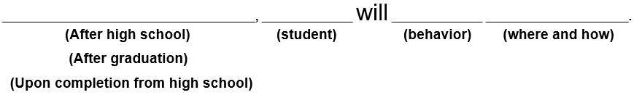
Formula for Writing Postsecondary Goals
Notes:
CLAUDIA
EdPlan IEP document when printed actually reads: Upon graduation from high school, I will….
For OAAP students in grades 9-12 and 18-22 ETPs, this really means is: What is their goal for AFTER completing all of their school years including any years they return for FAPE through an 18-22 ETP. Think of it as the postsecondary goal they strive to achieve “Upon completion or upon exit from all special education services in public school” or POST-school, the goal they want to achieve after they walk out the door.
This is not what their goal is or what they are going to do while in an 18-22 ETP, after completing 9-12 grade and graduating with an alternate diploma. It is their goal for what they are going to do after they leave school for good.

Slide 74
Writing Postsecondary Goals
Education and Training
  Upon completion, STUDENT will…
Employment
  Upon completion, STUDENT will…
Independent Living
  Upon completion, STUDENT will…
Community Participation
  Upon completion, STUDENT will…
Notes:
CLAUDIA

Slide 75
Education and Training
Postsecondary Goals
Non-example
Alexis plans to enroll in an adult care program for individuals with special needs in the Southeast.
Alexis wants to take a music class after high school.
Example
Upon completion, Alexis will attend a day habilitation program two days per week with individuals of similar age and needs, to maintain and improve communication and self-care skills.
Notes:
CLAUDIA
Ask participants to identify why the nonexample doesn’t work, based on the data and information from Alexis’ current transition assessments.
Show example after discussion – reason is mostly that non-examples don’t follow the PSG formula, are vague rather than specific or concrete, they leave out the where and how, are not observable or measurable…you can’t measure “plan”, “wants”, etc.

Slide 76
Employment
Postsecondary Goals
Non-example
Alexis hopes to work at the mall in a music store.
Alexis is thinking about applying for a job at the mall.
Example
Upon completion, given intense support from a job coach, Alexis will obtain part-time employment or a volunteer position in a setting she enjoys (the mall, a coffee shop, restaurant, or public music venue) at least two days a week.
Notes:
CLAUDIA
Ask participants to identify why the nonexample doesn’t work, based on the data and information from Alexis’ current transition assessments.
Show example after discussion – reason is mostly that non-examples don’t follow the PSG formula, are vague rather than specific or concrete, not observable or measurable…you can’t measure “hopes to”, “thinking about”, etc.

Slide 77
Independent Living
Postsecondary Goals
Non-example
Alexis will live at home with her parents.
Example
Upon completion, Alexis will independently use a Head Switch system of communication so that she can effectively communicate her wants and needs.
Notes:
CLAUDIA
Ask participants to identify why the nonexample doesn’t work, based on the data and information from Alexis’ current transition assessments.
Show example after discussion – reason is mostly that non-examples don’t follow the PSG formula, are vague rather than specific or concrete, while living at home is observable, it is not specific enough IL goal for what living at home needs to look like for Alexis

Slide 78
Community Participation Postsecondary Goals
Non-example
Alexis would like to take a music class.
Example
Upon completion, Alexis will join a local recreational program that includes music and interactions with members.
Notes:
CLAUDIA
Ask participants to identify why the nonexample doesn’t work, based on the data and information from Alexis’ current transition assessments.
Show example after discussion – reason is mostly that non-examples don’t follow the PSG formula, are vague rather than specific or concrete, leave out the where and how (e.g. a music class appropriate for Alexis’ functional level is not defined/described), are not observable or measurable…you can’t measure “would like to”, etc.
.

Slide 79
Alexis’ Annual Goals
Present Levels of Performance and Individual Needs
Measurable Postsecondary Goals
Annual Goals Related to Transition Service Needs
Courses of Study
Coordinated Set of Activities
Notes:
CLAUDIA

Slide 80
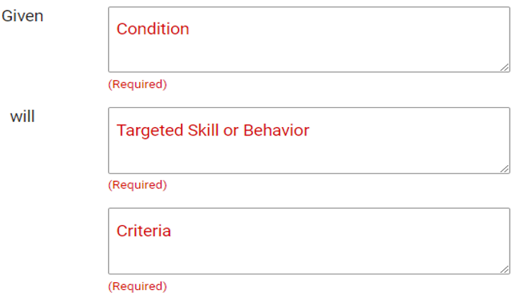
Formula for Annual Goals
Notes:
CLAUDIA
What you learned in classes/courses/college about goal-writing:
Who, will do what, under what conditions, how well
SMART goals – Specific, Measurable, Achievable, Relevant and Time Bound

Slide 81
Alexis’ Education and Training
Annual Transition Goal
Postsecondary Goal
Upon completion, Alexis will attend a day habilitation program two days per week with individuals of similar age and needs, to maintain and improve communication and self-care skills.
Assessment Need
  Personal Preference Indicator, Parent Interview
Annual Transition Goal
Given direct instruction on utilizing a head switch for communication, Alexis will independently (without teacher prompting) participate/actively respond in classroom activities 7/10 trials as measured by teacher-made rubrics.
Notes:
CLAUDIA

Slide 82
Alexis’ Education and Training Annual Transition Goal: Objectives
Objective 1: With moderate prompting (3-5 physical prompts), Alexis will utilize a head switch to answer yes and no questions 7/10 trials.
Objective 2: With minimal prompting (1-2 physical prompts), Alexis will utilize a head switch to answer yes and no questions 7/10 trials.
Objective 3: With moderate prompting (2-5 verbal prompts), Alexis will answer a story element question 7/10 trials.
Objective 4: With minimal prompting (1-2 verbal prompts), Alexis will answer a story element question 7/10 trials.
Notes:
CLAUDIA

Slide 83
Alexis’ Employment Annual Transition Goal
Postsecondary Goal
Upon completion, given intense support from a job coach, Alexis will obtain part-time employment or a volunteer position in a setting she enjoys (the mall, a coffee shop, restaurant, or public music venue) at least two days a week.
Assessment Need
Personal Preference Indicator, P-CAET, Parent Interview
Annual Transition Goal
Given direct instruction for completing a job-related task, and a system of least prompting provided by the job coach, Alexis will complete a job-related task (directing customers) 75% of the time by the end of the school year.
Notes:
CLAUDIA

Slide 84
Alexis’ Employment Annual Transition Goal: Objectives
Objective 1: Alexis will greet customers upon entering the coffee shop using a head switch with pre-recorded responses with minimal prompting (1-2 verbal prompts) 75% of the time .
Objective 2: Alexis will direct customers to complete an order form using a head switch with pre-recorded responses with minimal prompting (1-2 verbal prompts) 75% of the time .
Notes:
CLAUDIA

Slide 85
Alexis’ Independent Living
Annual Transition Goal
Postsecondary Goal
Upon completion, Alexis will independently use a Head Switch system of communication so that she can effectively communicate her wants and needs.
Assessment Need
Direct Observation, Parent Interview
Annual Transition Goal
Given 2 options for leisure activities to participate in during the school day, Alexis will identify her likes and dislikes by using her communication device 75% of the time.
Notes:
CLAUDIA

Slide 86
Alexis’ Independent Living Annual Transition Goal: Objectives
Objective 1: Alexis will express a like or dislike for one leisure activity by using her communication device 75% of the time.
Objective 2: Alexis will express a preference between two leisure activities using her communication device 75% of the time.
Notes:
CLAUDIA

Slide 87
Alexis’ Community Participation
Annual Transition Goal
Postsecondary Goal
Upon completion, Alexis will join a local recreational program that includes music and interactions with members.
Assessment Need
Personal Preference Indicator, Direct Observation, P-CAET
Annual Transition Goal
By the end of the school year, Alexis will explore recreational programs that include music by visiting two programs in person, and select a program of interest to participate in, as documented by teacher notes and family reports.
Notes:
CLAUDIA

Slide 88
Alexis’ Community Participation Annual Transition Goal: Objectives
Objective 1: With staff support, Alexis will be presented with at least three recreational program choices (via pictures, videos, or live demonstrations) and will indicate interest or preference through facial expression or head switch on 3 out of 5 opportunities.
Objective 2: Given two program options at a time, Alexis will indicate her preferred choice with 80% accuracy across three consecutive sessions.
Objective 3: With staff and family support, Alexis will attend at least one visit to a recreational or music-based program and participate by engaging in an activity (e.g., listening, moving with assistance, using instruments with adapted supports) for a minimum of 10 minutes.
Notes:
CLAUDIA

Slide 89
Alexis’ Course of Study
Present Levels of Performance and Individual Needs
Measurable Postsecondary Goals
Annual Goals Related to Transition Service Needs
Courses of Study
Coordinated Set of Activities
Notes:
CLAUDIA

Slide 90
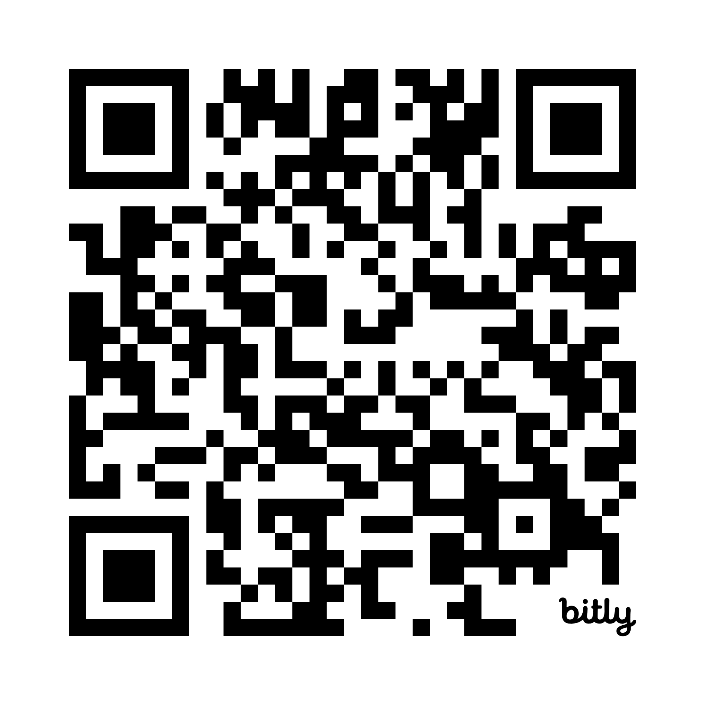
Which courses should Alexis take???
Scan QR code or enter short code.
  Open Course Codes link
  Extended transition codes start on page 13.
Identify courses that align with Alexis Post-Secondary goal.
Complete the Course Study template.
Extended Transition Program Codes, Titles, and Descriptions
bit.ly/4eLMqMK
Notes:
CLAUDIA
Group activity to complete course of study
NOTE: QR code goes direct to document, link goes to Alternate Diploma webpage
We also have this 2-page Alt Diploma (Grades 9-12) & ETP (Grade 13) Course Codes documentif we want to use it to save time, unless we prefer they see the 30-page document with course descriptions https://docs.google.com/document/d/1YmqqxgovQAbJxSjCxOrpGr54XVCyEtOi/edit?usp=drive_link&ouid=100698928415351692601&rtpof=true&sd=true (I have asked for it to be put on the webpage, but it’s not there yet.)

Slide 91
Which courses should Alexis take?
Grade 13 | Grade 13 - Year 2 | Grade 13 - Year 3 | Grade 13 -Year 4
Notes:
CLAUDIA
Example for them to fill in
Alexis in her second year, based on age so Grade 13 (year 1) can be left blank.
Have groups share a year and why they selected the courses.

Slide 92
Alexis’ Course of Study Example
Grade 13 | Grade 13 - Year 2 | Grade 13 - Year 3 | Grade 13 - Year 4
 | Applied Communication Skills 2 | Applied Communication Skills 3 | Applied Communication Skills 4
 | Applied Community Experiences 2 | Applied Community Experiences 3 | Applied Community Experiences 4
 | Applied Independent Living Skills 2 | Applied Independent Living Skills 3 | Applied Independent Living Skills 4
 | Work Based Learning 1 | Work Based Learning 2 | Work Based Learning 3
Notes:
CLAUDIA
Review courses and why we selected them if different from group choices.

Slide 93
Alexis’ Coordinated Set of Activities
Present Levels of Performance and Individual Needs
Measurable Postsecondary Goals
Annual Goals Related to Transition Service Needs
Courses of Study
Coordinated Set of Activities
Notes:
CLAUDIA

Slide 94
Alexis’ Education and Training
Coordinated Activities
Annual Transition Goal
Given direct instruction on utilizing a head switch for communication, Alexis will independently (without teacher prompting) participate/actively respond in classroom activities 7/10 trials as measured by teacher rubrics.
Coordinated Activities
Incorporate structured communication opportunities (answering yes/no questions, making choices, participating in greetings).
Practice initiating help requests during self-care tasks.
Notes:
CLAUDIA

Slide 95
Alexis’ Employment Coordinated Activities
Annual Transition Goal
Given direct instruction for completing a job-related task, and a system of least prompting provided by the job coach, Alexis will complete a job-related task (directing customers) 75% of the time by the end of the school year.
Coordinated Activities
Use role-play scenarios in the classroom to practice responding to customers given natural/environmental prompts.
Participate in job shadowing at community-based employment in preferred settings: music store, skating rink, and coffee shop.
Notes:
CLAUDIA

Slide 96
Alexis’ Independent Living Coordinated Activities
Annual Transition Goal
Given 2 options for leisure activities to participate in during the school day, Alexis will identify her likes and dislikes by using her communication device 75% of the time.
Coordinated Activities
Practice using the head switch to choose preferred activities during visits to school or community recreation events.
Receive weekly situational assessments through task analysis and work performance logs.
Notes:
CLAUDIA

Slide 97
Alexis’ Community Participation Coordinated Activities
Annual Transition Goal
By the end of the school year, Alexis will explore recreational programs that include music by visiting two programs in person, and select a program of interest to participate in, as documented by teacher notes and family reports.
Coordinated Activities
Use the device to initiate communication during recreation time.
Identify options for participation in recreational activities in the community.
Notes:
CLAUDIA

Slide 98
Artificial Intelligence (AI) and Digital Learning
Guidance and Considerations for Using Artificial Intelligence in Oklahoma K–12 Schools (Version 3.0)
  AI must support—not replace—professional judgment.
  Ethical AI use protects students and promotes equity.
Model Policy Artificial Intelligence-Updated October 2026
  Ensure accuracy, data privacy, and fairness through vigilant oversight.
  Use AI to enhance learning, not replace human judgment.
Free Asynchronous Courses in OSDE Connect
  Artificial Intelligence (AI) 101
  AI for Administrators and School Leaders
  AI Prompt Writing for K-12 Educators
Notes:
DONNA
Educators are responsible for reviewing and verifying all AI‑generated content to ensure accuracy, appropriateness, and alignment with instructional goals. Human oversight is required to maintain integrity, safeguard students, and prevent misuse.
Schools must use AI tools in ways that protect student data, uphold academic honesty, and ensure fair access. AI cannot be used for major decisions about students (such as grading or placement), and its use must comply with privacy laws and OSDE guidance.
Educators must verify AI-generated content to prevent factual errors and bias, safeguarding student data and equitable access. This includes setting clear boundaries to reduce over-reliance and maintaining academic integrity.
AI should support differentiated instruction, accessibility, feedback, and efficiency—but always under human guidance. Teachers must provide boundaries and guidelines for students’ AI use to foster independent critical thinking and ethical application.

Slide 99
Transition Case Study: David Rose
Adapted Travis
Notes:
DONNA

Slide 100
David’s Student Profile
Name: David Rose
Case Managers: Johnny Rose
Age: 15
Grade: 10
Special Education Category: Intellectual Disabilities

Slide 101
Assessment Battery for David
Pictorial Interest Inventory-SHEN
“What Jobs Do I Like” Worksheet from JOB Characteristics I Like Employment Goals Reproducible (Situational Assessment)
Personal Preferences Indicators (PII)
Transition Rating Scale 2.0 (Parent and Teacher Forms)
Direct Observation Data
Parent Input

Slide 102
David’s Present Levels
Present Levels of Performance including Current Transition Assessment Results
Measurable Postsecondary Goals
Annual Goals Related to Transition Service Needs
Courses of Study
Coordinated Set of Activities

Slide 103
David’s Present Levels:
Objective Statement 1
David Rose is a 10th grade student at Schitt’s Creek High School. He has limited verbal abilities, but has a few catch phrases such as, “I am good, thanks though”, “Quick no”, “Eat glass”, “Join the club” and “Uninterested." He also communicates through facial expressions. He smiles when he is happy and purses his lips and/or rolls eyes to express dislike. He uses gestures such as pointing or waving.
David can make choices when options are given to him and he uses his communication board with prompting, but he does not usually share his preferences on his own. Often, he communicates by using physical contact, such as grabbing someone’s arm to get their attention or slapping. This type of behavior has been happening more often, and staff are keeping track so they can support him in learning safer and more appropriate ways to get attention.

Slide 104
David’s Present Levels:
Objective Statement 2
David has many strengths, especially with computers and using assistive technology. He likes to know the rules or expectations. He feels most comfortable in small group settings with his preferred people. He prefers to be indoors and participate in structured activities.
David enjoys listening to music and loves pop culture. His interests in culinary arts or high-end food can be used to motivate him. Areas where he needs support include communicating his choices more independently, using appropriate ways to get attention, and improving his mealtime independence. David can dress himself. He prefers to only wear black and white.

Slide 105
David’s Strengths
David is mobile and his upper body is strong (parent and staff input).
David can make simple choices using PECS (PII, SL data).
He can use an i-Pad to play specific games and complete tasks (PII).
David has a younger sister that attends school with him and is has a best friend named Stevie (PPI, family input).
He shows eagerness to connect with others over his preferred topics (PPI).
He is able to express his feelings through facial expressions.

Slide 106
David’s Interests
He is interested in pop culture, culinary arts, fashion, and Japanese culture.
He likes to look in fashion magazines and watch videos about fashion and skin care.
He enjoys listening to Mariah Carey.
He likes to play board games.

Slide 107
David’s Postsecondary Goals
Present Levels of Performance including Current Transition Assessment Results
Measurable Postsecondary Goals
Annual Goals Related to Transition Service Needs
Courses of Study
Coordinated Set of Activities

Slide 108
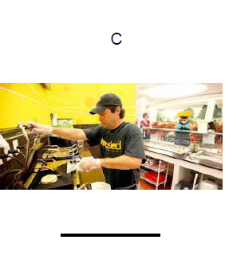
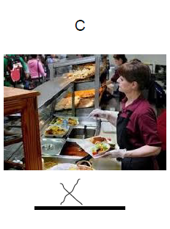
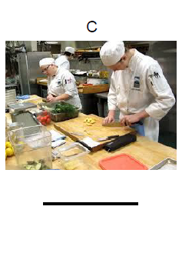
Food Service Career Picture Selections

Slide 109
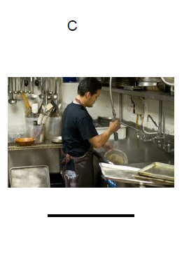
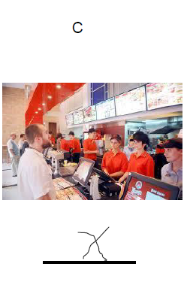
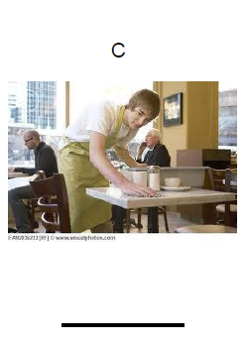
Food Service Picture Selections - 2

Slide 110
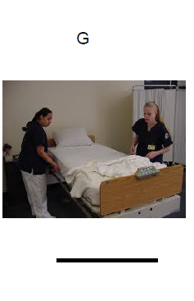

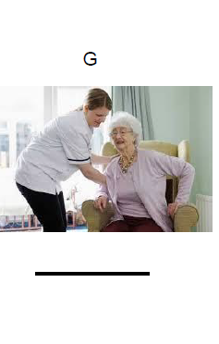
Caring For Others Picture Selections

Slide 111
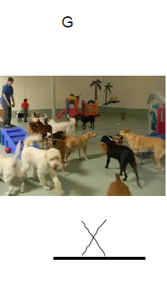
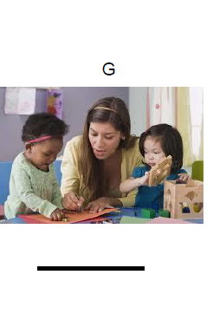
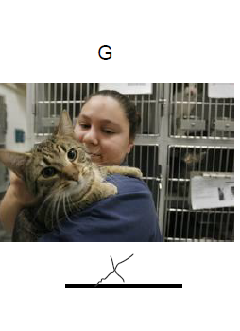
Career For Others Picture Selections - 2

Slide 112
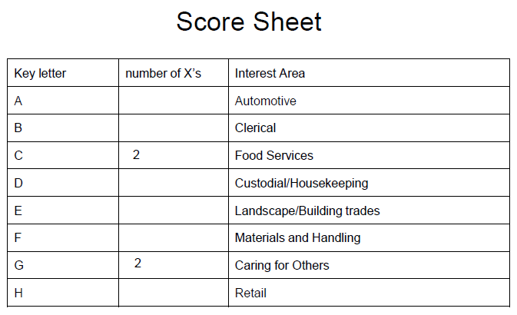
Pictorial Interest Inventory
Top Interests

Slide 113
What caught David’s Eye?
What do you notice about the pictures David selected in the Food Services careers?
What do you notice about the pictures David selected in the Caring for Others careers?

Slide 114
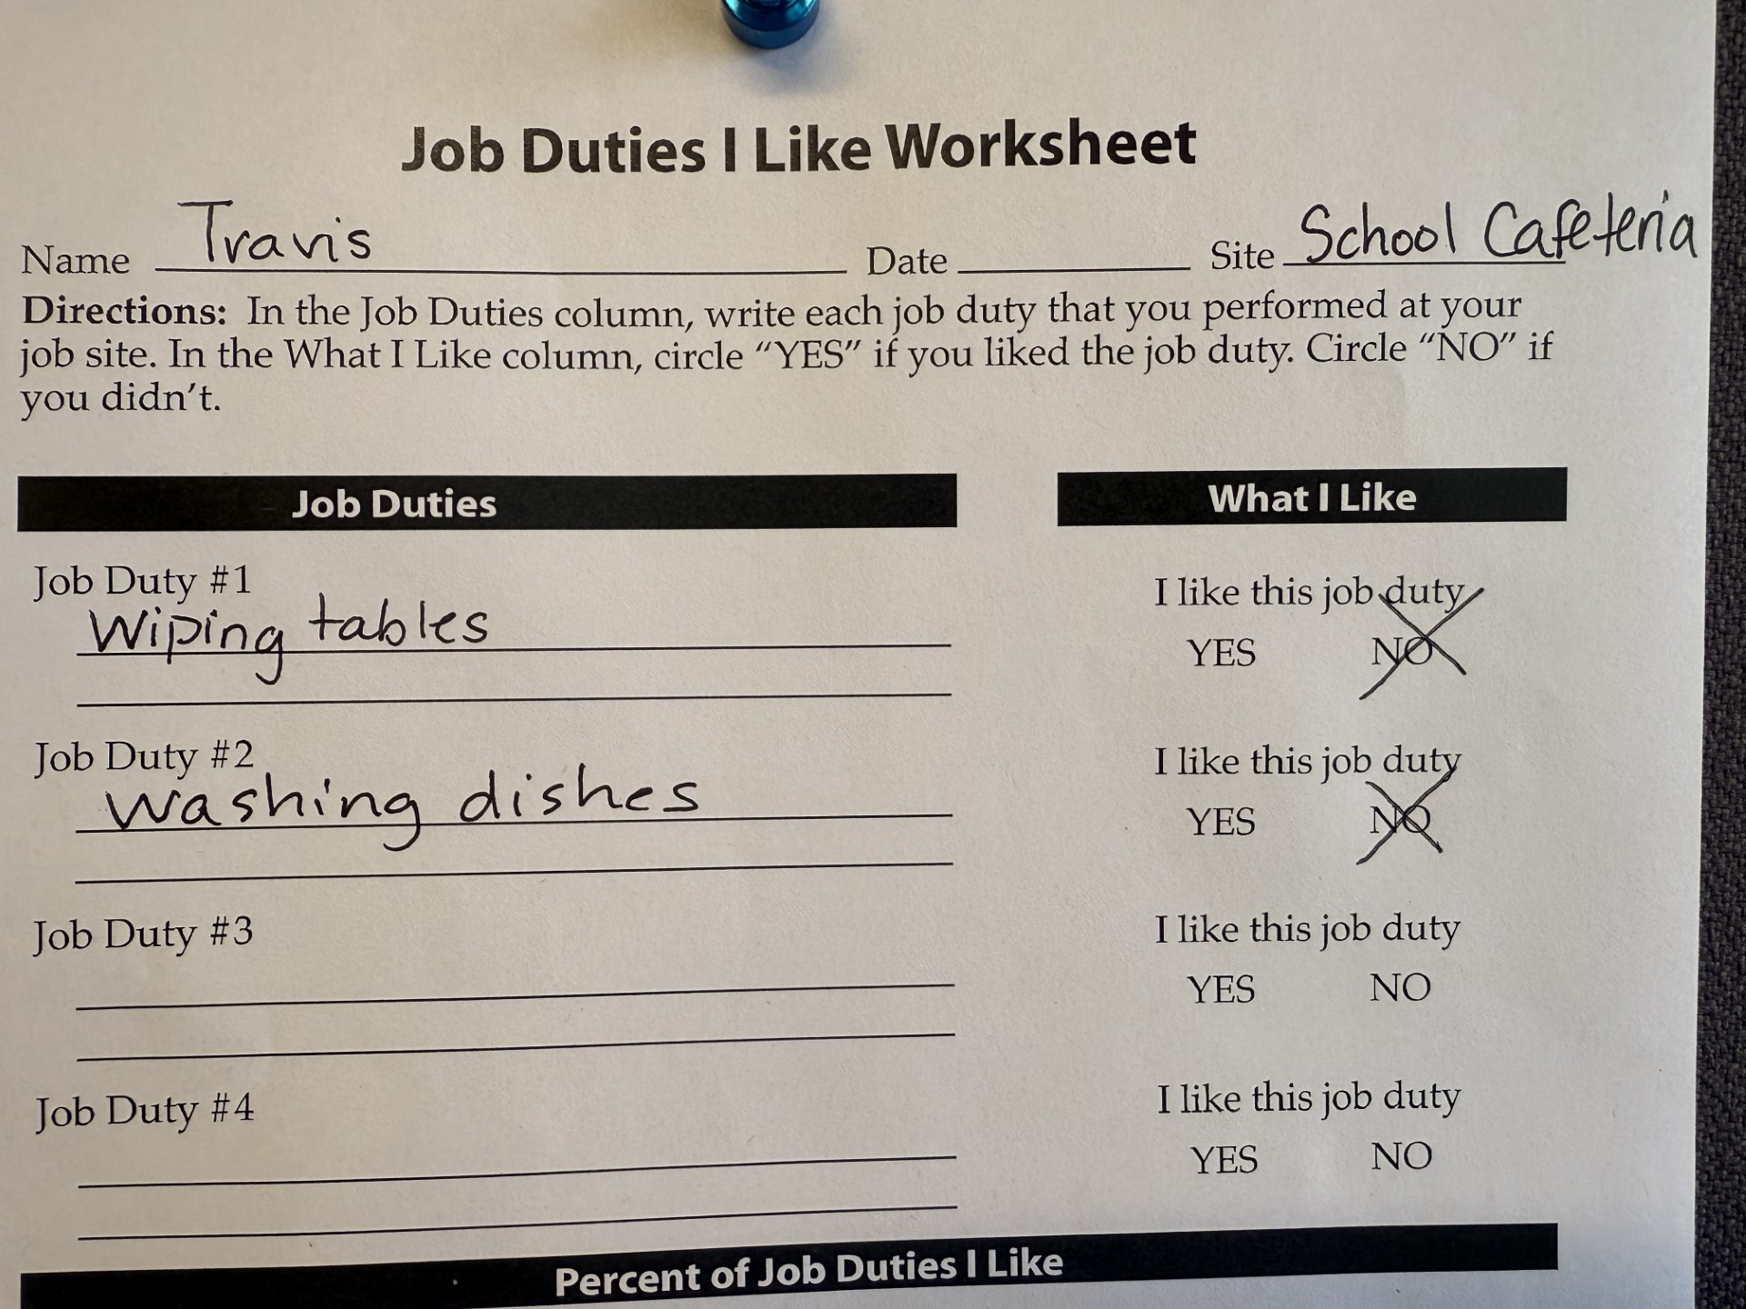
Job Duties I Like Worksheet

Slide 115
Formula for Writing Postsecondary Transition Goals

Slide 116
Writing Postsecondary Goals
Education/Training (ED)
  Upon graduation from high school, David (I) will…
Employment (EMP)
  Upon graduation from high school, David (I) I will…
Independent Living (IL)
  Upon graduation from high school, David (I) will…
Community Participation (CP)
  Upon graduation from high school, David (I) will…

Slide 117
David’s Postsecondary Goal 1
Education and Training
Upon graduation from high school, David will participate in supported employment training at the local high school or community college.
Employment
Upon graduation from high school, David will work as a stocking assistant in a small or boutique store.

Slide 118
David’s Postsecondary Goal 2
Independent Living
Upon graduation from high school, David will live with his parents, taking care of his self-care needs and performing household tasks as independently as possible.
Community Participation
Upon graduation from high school, David will attend small-group interest meet ups (game nights, themed events) at the community center with appropriate social skills.

Slide 119
David’s Annual Goals
Present Levels of Performance including Current Transition Assessment Results
Measurable Postsecondary Goals
Annual Goals Related to Transition Service Needs
Courses of Study
Coordinated Set of Activities

Slide 120
Formula for Annual Transition Goals

Slide 121
Group Activity
In your group, create the annual goal with objectives and coordinated activities.
  Pick one area
    Education and Training
    Employment
    Independent Living
    Community Participation
Use your favorite or school approved AI tool to assist.
Select someone in your group to share your area.

Slide 122
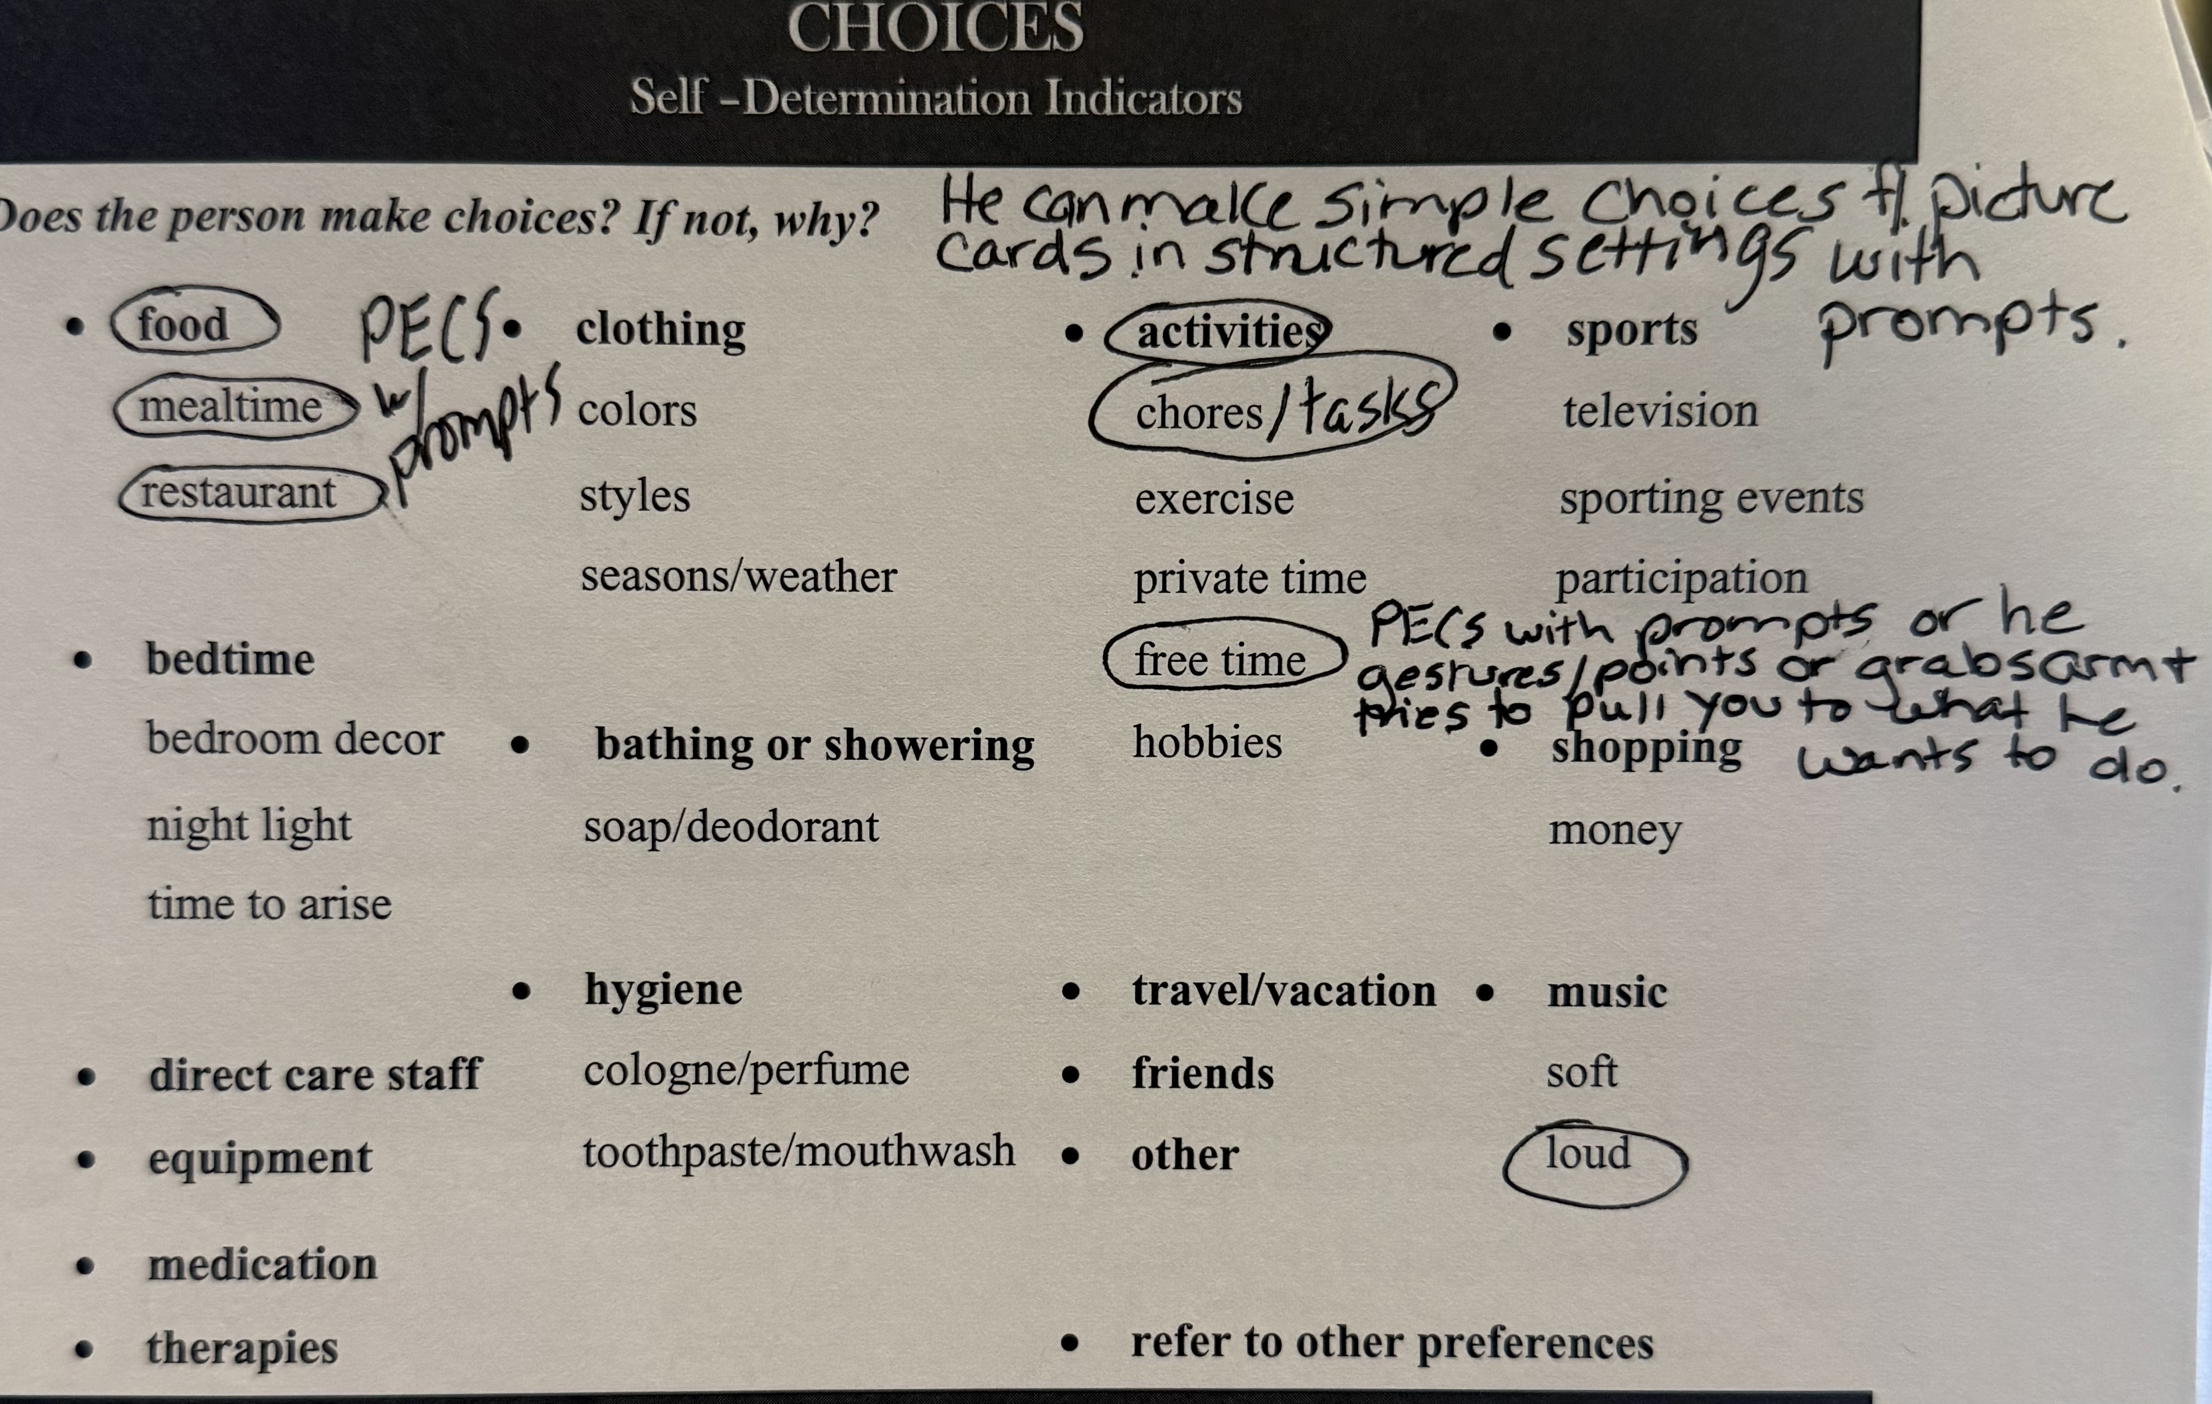
Personal Preferences Indicators Results
What specific Education/Training need does this data show?

Slide 123
David’s Education and Training
Annual Transition Goal
Postsecondary Education/Training Goal
Upon graduation from high school, David will receive on-the-job training at the local high school or community college.
Assessment Need
Increase self-determination skills by communicating choices (PII).
In your group, create the annual education and training goal with objectives.
Use your favorite or school approved AI tool to assist.
Notes:
You can input the PLAFFP, SPIN, and assessment results. DO NOT USE THE STUDENT'S NAME or any other personal identifier information.
You can use AI as an idea generator or to refine your own thoughts.
You can input the formula to generate the goal.
ALWAYS verify that it personalized for the student and your community.

Slide 124
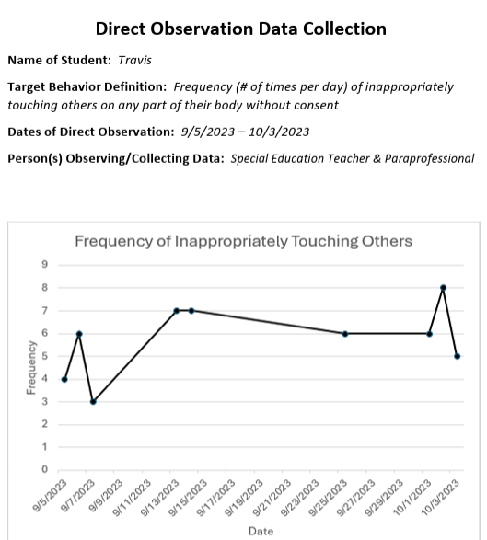
Behavior Data Results
David
What specific Employment need does this data show?

Slide 125
David’s Employment Annual
Transition Goal
Postsecondary Employment Goal
  Upon graduation from high school, David will work as an equipment assistant (helping set up gear, moving equipment, organizing weights).
Assessment Need
Increase appropriate interactions by keeping hands to himself.
In your group, create the annual education and training goal with objectives.
Use your favorite or school approved AI tool to assist.

Slide 126
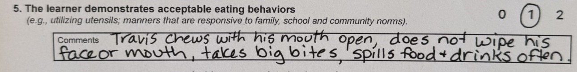
Transition Rating Scale 2.0 - Home Living: Personal Care
What specific IL need does this data show?

Slide 127
Direct Observation Results
Observation
During the observed lunch, David:
Chewed with his mouth open on 4 out of 5 bites.
Did not wipe mouth or face after eating on 5 out of 5 opportunities.
Spilled food or drink on clothing on 3 out of 5 opportunities.
What specific Independent Living needs does this data show?

Slide 128
David’s Independent Living Annual Transition Goal
Postsecondary Independent Living Goal
Upon graduation from high school, David will live with his parents, taking care of his self-care needs and performing household tasks as independently as possible.
Assessment Need
Improve table manners
In your group, create the annual education and training goal with objectives.
Use your favorite or school approved AI tool to assist.

Slide 129
Transition Rating Scale 2.0 Parent Results & Parent Concerns
David's mom shared that recently they haven't been taking David to many events because he doesn't always stay with the group.
What specific Community Participation need does this data show?

Slide 130
David’s Community Participation Annual Transition Goal
Postsecondary Community Participation Goal
  Upon graduation from high school, David will attend local sporting events with his family.
Assessment Need
  Stay with the group during community outings.

Slide 131
Group Share
Education and Training
Employment
Independent Living
Community Participation

Slide 132
Survey
Please complete our survey about the training.
Notes:
We use this feedback to improve future trainings and refine topic areas.
We will follow up on all questions or requests.
There will be follow up surveys about implementation. If you complete them you will be entered for a chance to win a gift card.
The overview evaluation data is used for our grant reporting.

Slide 133
PATHWAYS TO PARTNERSHIPS
PLAN YOUR WAY OK
Instead of searching across multiple platforms, let the Plan be your guide to streamlined, organized, and impactful secondary transition support—for every step of the journey.

Slide 134
Pathways to Partnerships Staff
Program Director
Lori Chesnut lori.chesnut@sde.ok.gov
Program Manager
Donna Tye-Lewis donna.tye-lewis@sde.ok.gov
Transition Specialists
Claudia Beckner claudia.beckner@sde.ok.gov
Dr. Erin Berry erin.berry@sde.ok.gov
April Bowden april.bowden@sde.ok.gov

Slide 135
Plan Your Way OK U.S. Department of Education Grant Disclaimer

